Slide 1

HUSTLE
3 Musketeers and a Rifleman
Bennett DenBleyker: User Access and Authorization
Jacob Haight: Account Balances and Transfers
Hagen Larsen: User Experience and Design
Jade Blunt: Job Functionality and Documentation

Slide 2
Design Decisions and Fulfilled Requirements
Reusable templates for similar views
4.2.1: A Worker must be able to view available jobs 3.3.1: A Customer must be able to change the details of the job if it has not been claimed 5.2.1: An Owner must be permitted to review complaints submitted by Customers
Three states of jobs
3.2.1: A Customer must be permitted to create and post jobs for Workers to acquire 3.7: A Customer can cancel any job up to 24 hours before the start time of the job 4.3.1: A Worker must be able to mark accepted jobs as complete
Workers can bid on jobs
3.2.2: A Customer must be permitted to approve or decline Workers that have placed a bid on the Customer’s job. 4.2.2.3: When bidding on a job, a Worker must also define the wage that they will accept. This can be different than the proposed wage by the Customer.
Surveys of Jobs by Workers
4.2.2: A Worker must be able to bid on jobs they would like to work 4.3.2.1: The survey must include the degree of complexity of the job (relative to expectation) 4.3.2.2: The survey must also include the duration of the job (relative to the expected duration)

Slide 3
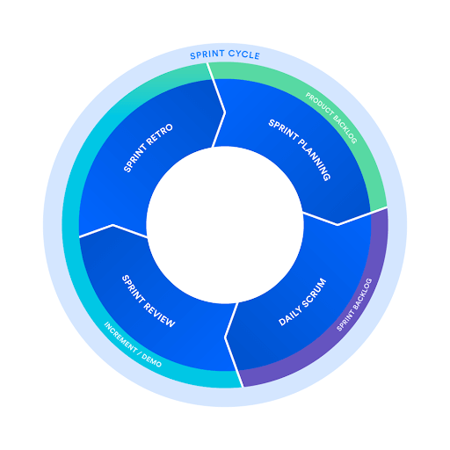
SCRUM Practices
Sprints
Two-week periods of time
Started with a planning meeting
Multiple standup meetings throughout
Retrospective at the end
All tasks logged and tracked in the backlog in Github
Scrum Master:
In charge of maintaining the backlog and keeping the sprint on task
Alternated each sprint
All sprint documents are located in the git repository in docs/planning/

Slide 4
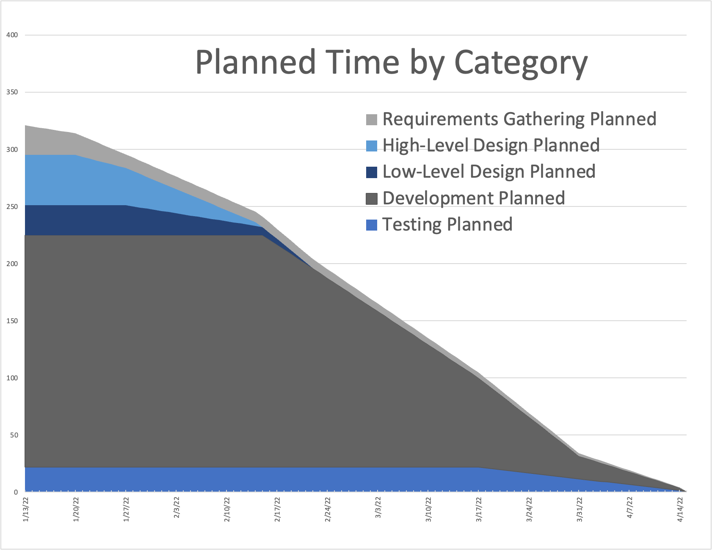
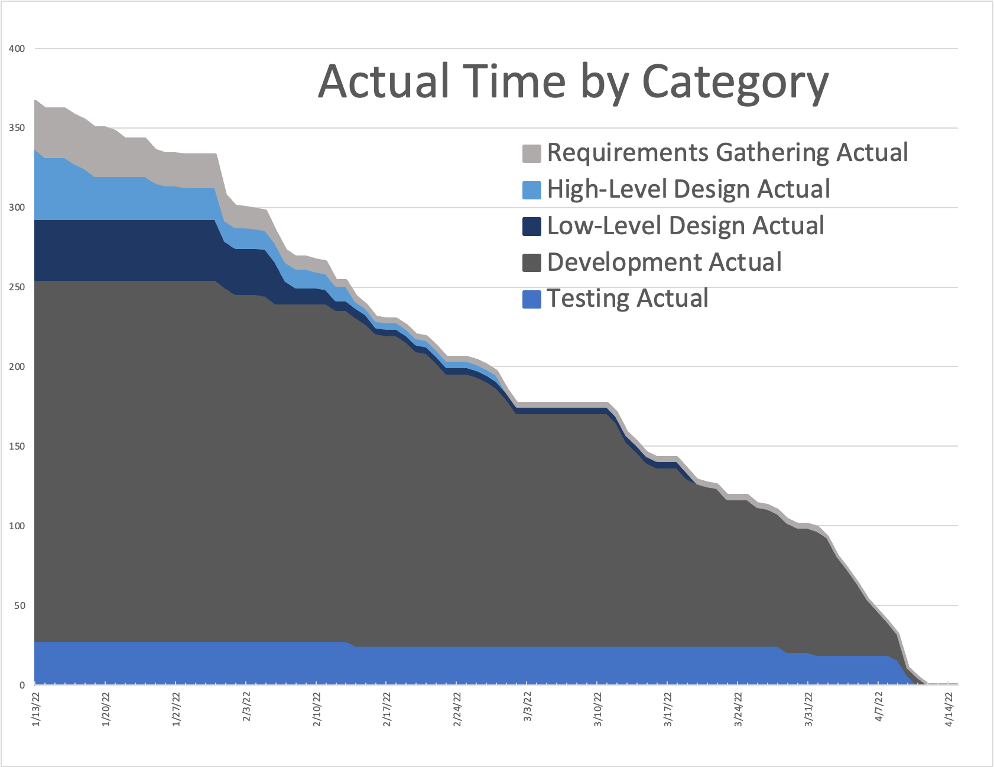
Burndown
Spring Break
Planned Velocity for each Milestone (team hours/day)
Actual Velocity for each Milestone (team hours/day)
1 | 2 | 3 | 4
1.8 h/d | 2.8 h/d | 4.7 h/d | 2.4 h/d
1 | 2 | 3 | 4
2.4 h/d | 4.9 h/d | 3.1 h/d | 7.2 h/d
Notes:
Planned Velocities per Sprint:
Sprint 1: 1.8 h/d
Sprint 2: 2.8 h/d
Sprint 3: 4.7 h/d
Sprint 4: 4.7 h/d
Sprint 5: 4.7 h/d
Sprint 6: 2.4 h/d
Actual Velocities per Sprint:
Sprint 1: 2.4 h/d
Sprint 2: 4.9 h/d
Sprint 3: 3.8 h/d
Sprint 4: 2.4 h/d
Sprint 5: 3.1 h/d
Sprint 6: 7.2 h/d
Total Project Planned Velocity:
3.5 team-hours/day
Total Project Actual Velocity:
3.9 team-hours/day

Slide 5
Testing Procedures
Correctness of Code
Deployment
Milestone 3: We created unit testing. These tests can be ran by running:
python manage.py test
after completing all the build instructions. Extended instructions can be found in the README.md document.
Milestone 4: We ran system testing by testing the app as a whole. Each requirement from our requirements definition document was checked. Every use case was ran through.
We are confident that our code is correct and professional. We know that our app does what we intended it to do. It is simple and easy to read. It follows the ACM code of ethics. Our testing procedures have helped prove this.
Our code is ready for deployment. We have tested the code and verified its correctness. In the context of this course, deployment means submitting the project and turning it in. However, if we were planning to actually deploy this, we believe it would be ready.

Slide 6
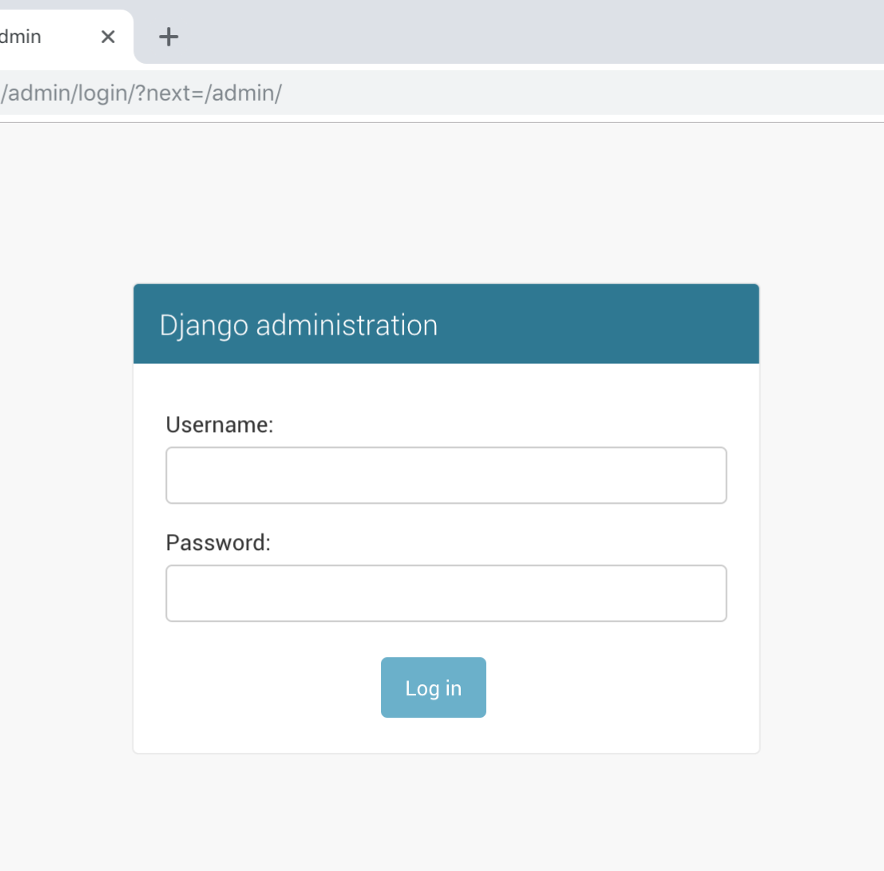
User Registration - Requirement Definition
From Requirements Definition
1.1. A user must authenticate using an email address and password before gaining access to the system.
1.1.1. A user must be able to create a new account by providing an email address and password. The user should also provide:
1.1.1.1. A preferred contact method (Email, Phone)
1.1.1.2. A phone number (if phone preferred)
1.1.1.3. For Customers - An address
1.1.2. For future logins, if a user enters an incorrect email address/password combination, they must be allowed to attempt another login.
Notes:
FURPS:
Functionality - We needed a user account to authenticate users into the system, associate app activity with a user, and provide a profile that other users could view to determine some things about them.
Usability - We need it to be uniform for each user. We also needed it to be quick and efficient to help users easily get into our app. We wanted to make sure it was forgiving if invalid credentials were provided.
Reliability - Authentication into the system is one of the most frequent activities a user can perform - it needs to work consistently.
Performance - We needed this to scale with our application, to handle a significant number of users, and to happen quickly with no delay.
Supportability - We needed this to work for all user types.
MOSCOW:
Must Have - Clearly stated in the requirements definition.
Should Have - A phone number, address
Could Have - A preferred contact method
Won’t - prohibit a user from trying again if they initially enter the incorrect information.
From Requirements Definition:
1.1. A user must authenticate using an email address and password before gaining access to the system.
1.1.1. A user must be able to create a new account by providing an email address and password. The user should also provide:
1.1.1.1. A preferred contact method (Email, Phone)
1.1.1.2. A phone number (if phone preferred)
1.1.1.3. For Customers - An address
1.1.2. For future logins, if a user enters an incorrect email address/password combination, they must be allowed to attempt another login.

Slide 7
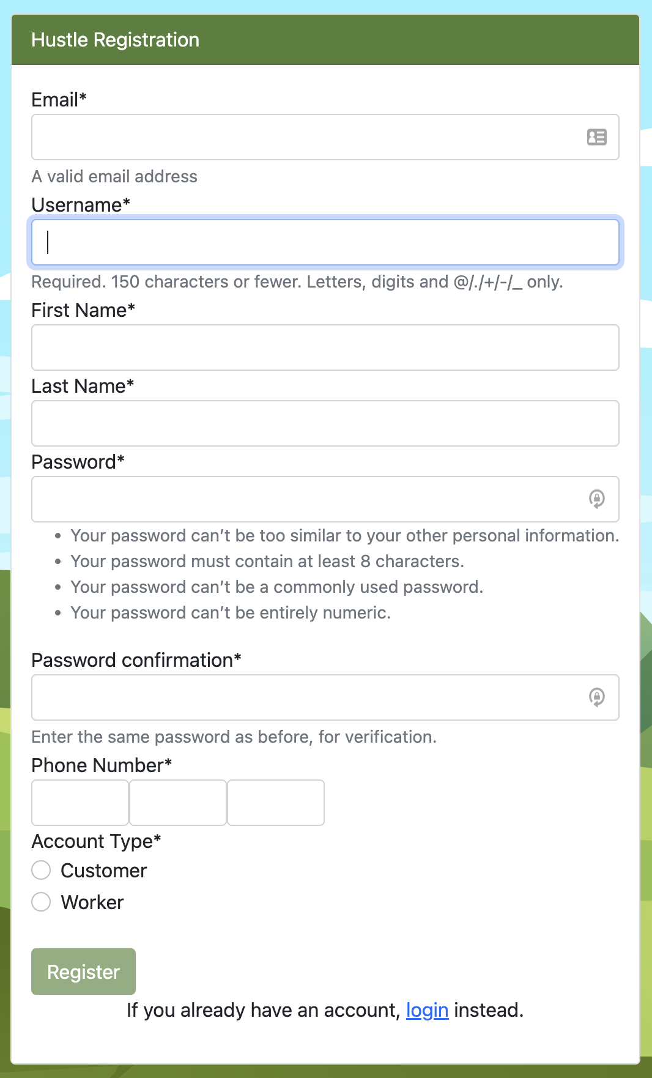
User Registration - Design Choices
Django Built-In Authentication
Pros
Username, Secure Password
Users could be affiliated with Groups
Cons
No email, address, phone number, etc.
No way for users to register themselves
Leveraged existing functionality,
modified to meet our needs.
Notes:
Django Built-In User Authentication
Django has built-in functionality to authenticate users, but it didn’t have everything we needed. We wanted to be efficient and leverage existing functionality, while adapting it to meet our needs.
We decided to use the “Groups” feature of Django Authentication to classify different types of users and control their authorized actions. After selecting a user type, the system would place them into that type’s group.
We inherited the UserForm and User model provided by Django and added our own custom fields: namely, address, phone number, first name, last name, email, etc.
We used a UserForm to gather input from the user and register it into the database. Django Forms work great for collecting information and posting it to the database - we just had to show it where to go.

Slide 8
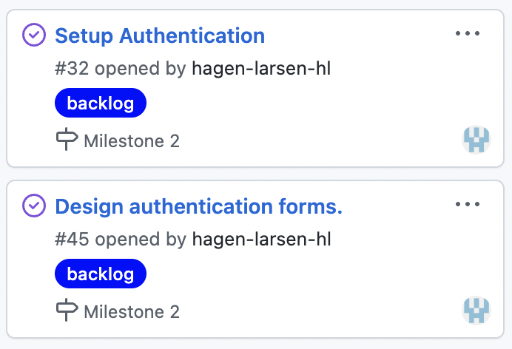
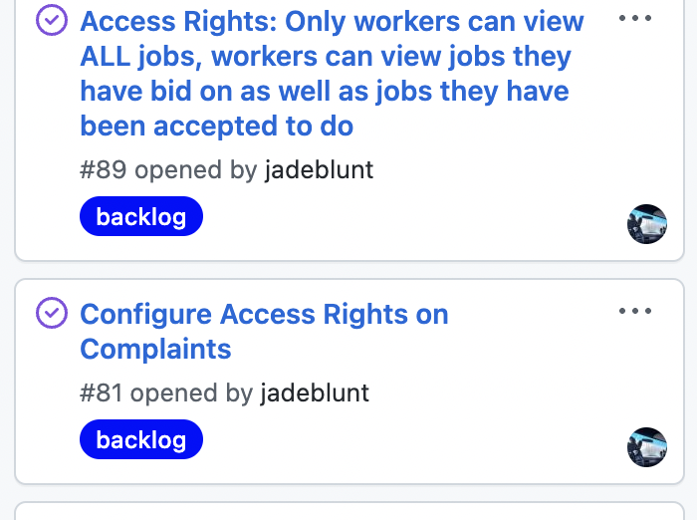
User Registration - Tasks
Milestone 2
32 - Setup Authentication - Hagen
45 - Design Authentication Forms - Hagen
Milestone 3
Tasks 81, 88, 89 - Cleanup/Simplification - Bennett
Task 121 - Access Rights - Bennett
Notes:
GitHub Project Issues:
32, Setup Authentication, Hagen
This was the initial setup. After completion of this task, and admin could register users, but only with a username and password.
45, Design Authentication Forms, Hagen
After this task was completed, users could register themselves through a simple form. Custom fields were added to the user at this time.
121, Authentication Cleanup/Simplification, Bennett
After this task was completed, user registration was complete. The form was finalized. Errors were also displayed in the event of an incorrect password or username.
81, 88, 89, Access Rights, Bennett
After completion of this step, a user’s account type was affiliated with a Group, and users were actually restricted from viewing things they shouldn’t see within the application.

Slide 9
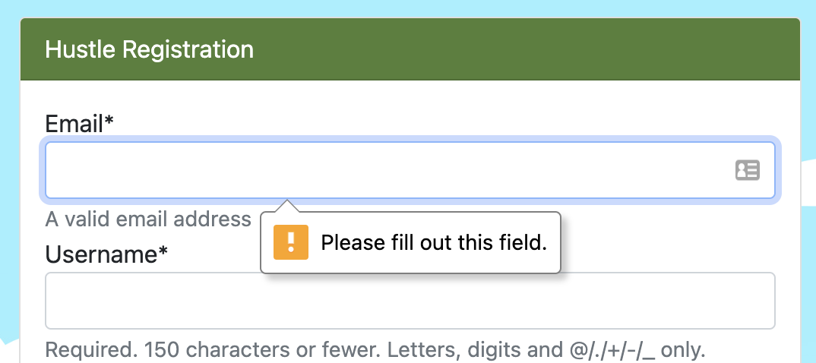
User Registration - Testing, Dependencies
Dependencies
This part of the app didn’t depend on anything else (other than the project being created), however most everything else in the app depended on authentication!
It was imperative to get this done early
Testing:
Testing for this requirement was done by executing our use cases while monitoring the data being stored through the Django Admin portal
Notes:
Dependencies: This part of the application didn’t depend on anything - however, the rest of the application depended on this! It was important that we got this done, which is why it was done so early in Milestone 2. Having the basis for authentication helped us establish a lot of things later on.
Testing: Testing for this was primarily done by executing our use cases and monitoring records created in the Django Admin portal.

Slide 10
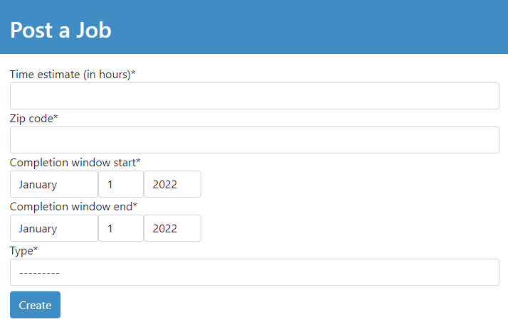
Job Posting - Requirement Definition
From Requirements Definition
3.2. Post Jobs
3.2.1. A Customer must be permitted to create and post jobs for Workers to acquire.
3.2.1.1. A job must be categorized
3.2.1.2. A job must include an expected time to completion for the job.
3.2.1.3. A job must include a desired completion window for when the job can be performed.
3.2.2. A Customer must be permitted to approve or decline Workers that have placed a bid on the Customer’s job.
3.2.2.1. Payment must happen from Customer to Owner at this time.
/jobs/create
Notes:
FURPS:
Functionality - Jobs are the most important piece of the app; literally, the object and purpose of it.
Usability - Should be simple, obvious, and quick to glance over. Workers will be seeing a lot of these, and customers should be able to create them easily.
Reliability - If this piece doesn’t work reliably, then the whole project is pointless.
Performance - Since a huge number of jobs will (hopefully) be created as time goes on, operations upon them must be quick and simple for users of all types.
Supportability - Should have options for many different types of jobs.
MOSCOW:
Must Have - Clearly stated in the requirements definition
Should Have - Good selection and scheduling methods
Could Have - Notifications for new jobs
Won’t - Complex scheduling method
From Requirements Definition
3.2. Post Jobs
3.2.1. A Customer must be permitted to create and post jobs for Workers to acquire.
3.2.1.1. A job must be categorized
3.2.1.2. A job must include an expected time to completion for the job.
3.2.1.3. A job must include a desired completion window for when the job can be performed.
3.2.2. A Customer must be permitted to approve or decline Workers that have placed a bid on the Customer’s job.
3.2.2.1. Payment must happen from Customer to Owner at this time.

Slide 11
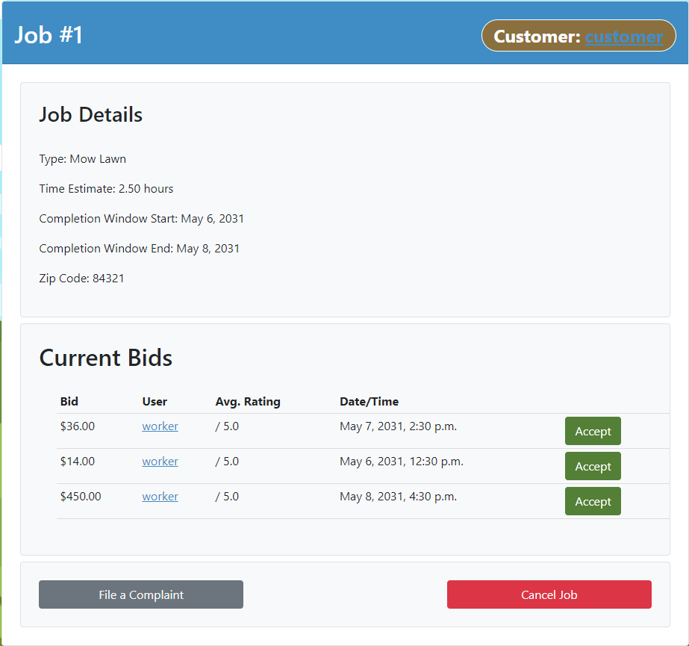
Job Posting - Design Choices
/jobs/view/1
Selection Method: Bidding
Pros
Who you pick is your fault
Creates competition between workers
Cons
Requires several stages of bidding/acceptance
Requires some way to value individual workers
Notes:
Job Posting
Selection Method: Bidding
Pros & Cons
Scheduling Method: Completion Window
Compensation Method: Complaints
Cancellation Method: Cancel/Rescind

Slide 12
Job Posting - Tasks
From Requirements Definition
3.2. Post Jobs
3.2.1. A Customer must be permitted to create and post jobs for Workers to acquire. (/jobs/create)
3.2.1.1. A job must be categorized (JobType Model)
3.2.1.2. A job must include an expected time to completion for the job. (Time Estimate field)
3.2.1.3. A job must include a desired completion window for when the job can be performed. (Completion Window fields)
3.2.2. A Customer must be permitted to approve or decline Workers that have placed a bid on the Customer’s job. (Accept button)
3.2.2.1. Payment must happen from Customer to Owner at this time. (It does :D)
Job Form: #55 (Jade)
JobType Model: #57 (Jade)
Job Model: #58 (Jade)
Job View: #72 (Jade)
Include Bids: #85 (Jade)
Bid Functionality: #84 (Jade)
Bid View: #85 (Jade)
Bid Model: #87 (Jacob)
Access Rights / Ownership: #88 (Bennett)
Access Rights / Roles: #102 (Bennett)
Adding Job States: #106 (Jade)
Styling: #118 (Hagen)
Styling: #158 (Jade)
9 Commits to the Model Form
10 Commits to the Create Template
23 Commits to the View Template
24 Commits to the Python Handler
Notes:
3.2. Post Jobs
3.2.1. A Customer must be permitted to create and post jobs for Workers to acquire. (/jobs/create)
3.2.1.1. A job must be categorized (JobType Model)
3.2.1.2. A job must include an expected time to completion for the job. (Time Estimate in image)
3.2.1.3. A job must include a desired completion window for when the job can be performed. (Completion Window in image)
3.2.2. A Customer must be permitted to approve or decline Workers that have placed a bid on the Customer’s job. (Accept button in image)
3.2.2.1. Payment must happen from Customer to Owner at this time. (It does :D)

Slide 13
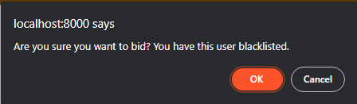

Job Posting - Testing, Dependencies
Dependencies
Job Model
User Model
JobType Model
Bid Model
Testing
Use cases
Django Shell
A keen eye
Notes:
Dependencies
Depends on the Job and Bid models, which result in a dependency on the User and JobType models
Testing
Use cases - ensuring that everything had basic functionality.
Django Shell - ensuring data was being computed properly by modifying different attributes separately.
A keen eye - lots and lots of GUI and styling work, and looking for improper display of job attributes.

Slide 14
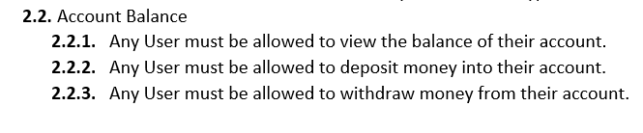
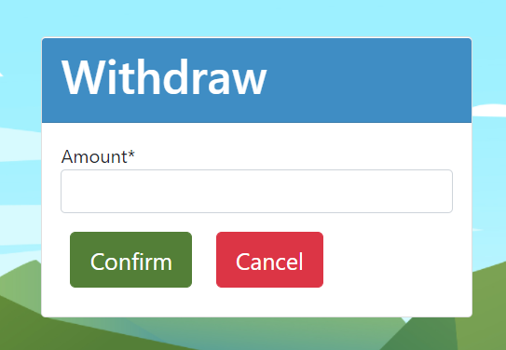
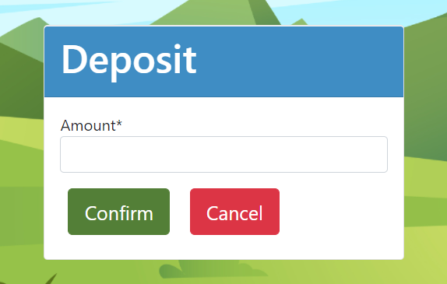
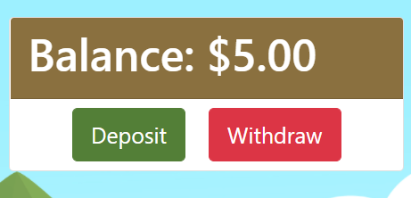
Account Balance - Requirements Definition

Slide 15
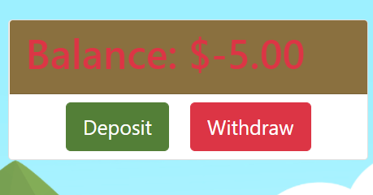
Account Balance - Design Choices
Withdrawing and Depositing
Pros
Pop up is makes the total UI less cluttered
Users can deposit money and withdraw money
Cons
Popup is in a weird place

Slide 16
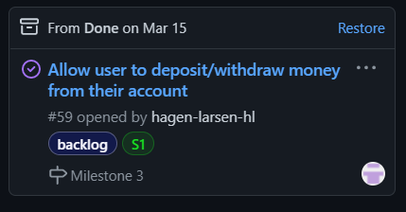
Account Balance - Tasks
Completed in Sprint 1 by Jacob Haight

Slide 17
Account Balance - Testing, Dependencies
Dependencies
This only depended on the user data, because that is where the users money amount is stored
Other process are dependent on this to be able to access the users money
Testing:
This is tested in the unit tests to make sure that the user can add and subtract money from the account and that it will save

Slide 18

Videos

Slide 19
Project Resources
Atlassian, & Drumond, C. D. (2022). What is Scrum? Atlassian. https://www.atlassian.com/agile/scrum
The web framework for perfectionists with deadlines | Django. (2022). Django. https://www.djangoproject.com
Otto, M. J. T. (2022). Bootstrap. Bootstrap. https://getbootstrap.com
Github. (2022). Github Docs. Github Documentation. https://docs.github.com/en
Atlassian. (2022). Learn burndown charts with Jira Software. Burndown Charts. https://www.atlassian.com/agile/tutorials/burndown-charts

Slide 20
Questions?

